Slide 1
IPL 22 Analysis

Slide 2
Introduction:
In this presentation, we'll be taking a closer look at IPL 2022 and analyzing some of the key trends and insights that have emerged from the tournament so far. We'll explore the performance of each team, individual players, and how different strategies have played out on the field.

Slide 3
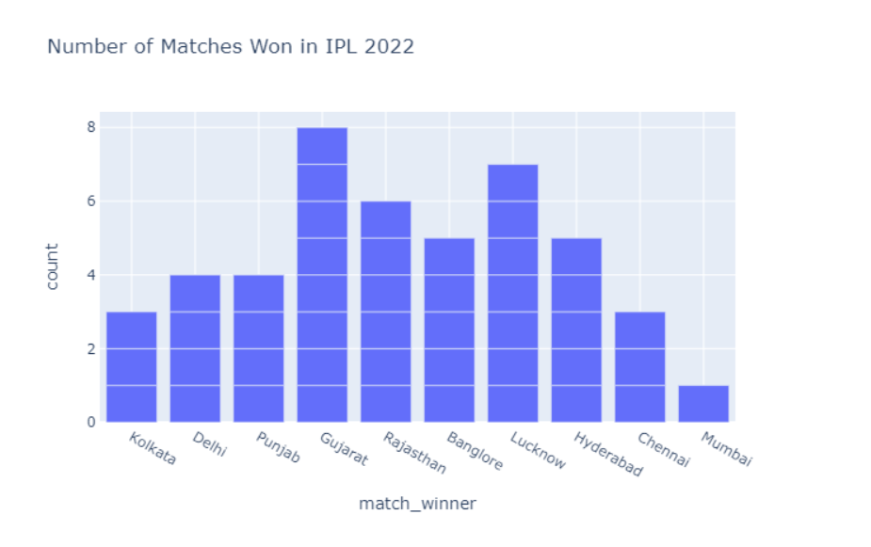
number of matches won by each team:
So from this Viz., we can say, Gujrat has the most number of wins in IPL 2022 with 8 wins. It is an achievement as a new team for Gujrat in IPL.

Slide 4
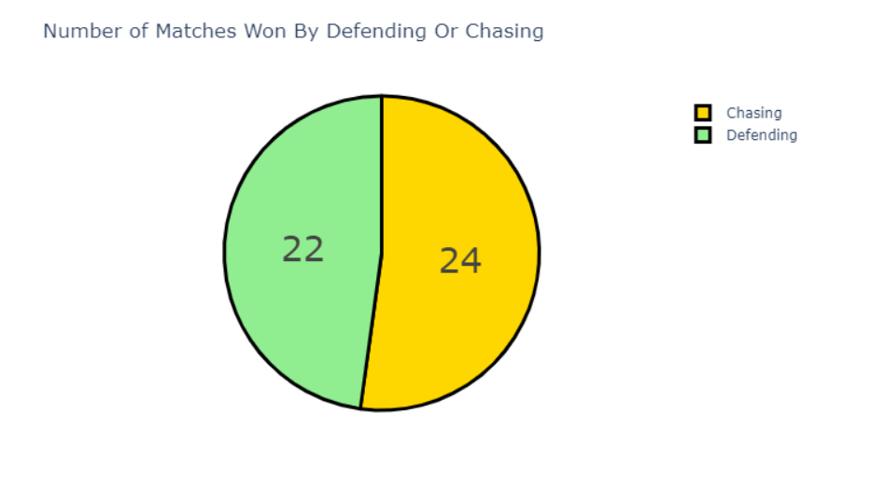
Number of Matches Won By Defending Or Chasing
From this we say that, 24 matches are won while chasing the target, and 22 matches are won while defending the target.

Slide 5
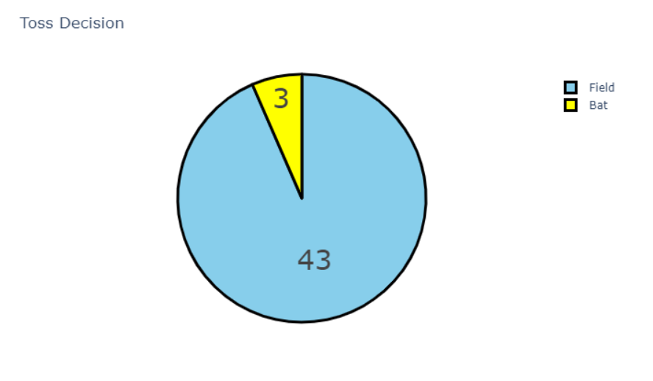
Toss decision:
Thus, most captains choose to field after winning the toss. So far, in 43 games, captains have chosen to field first, and in just three games, the captains have chosen to bat first.

Slide 6
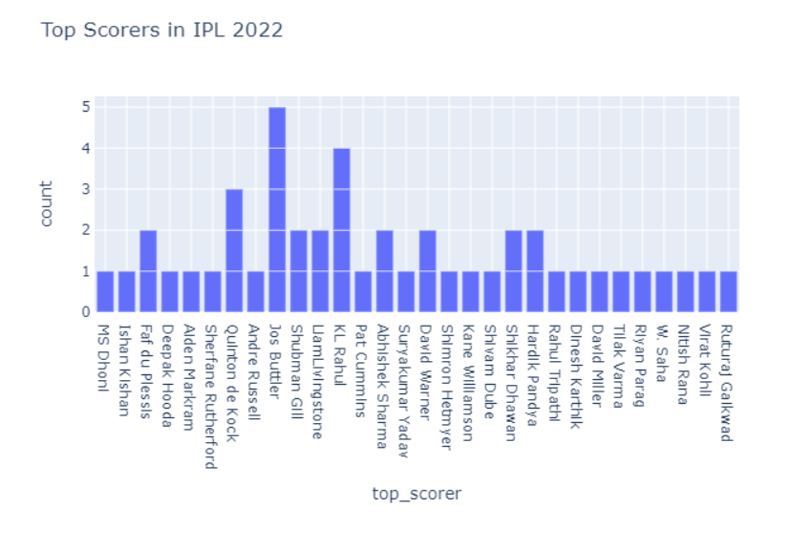
top scorers
Currently, Jos Butler has been a top scorer in 5 matches.

Slide 7
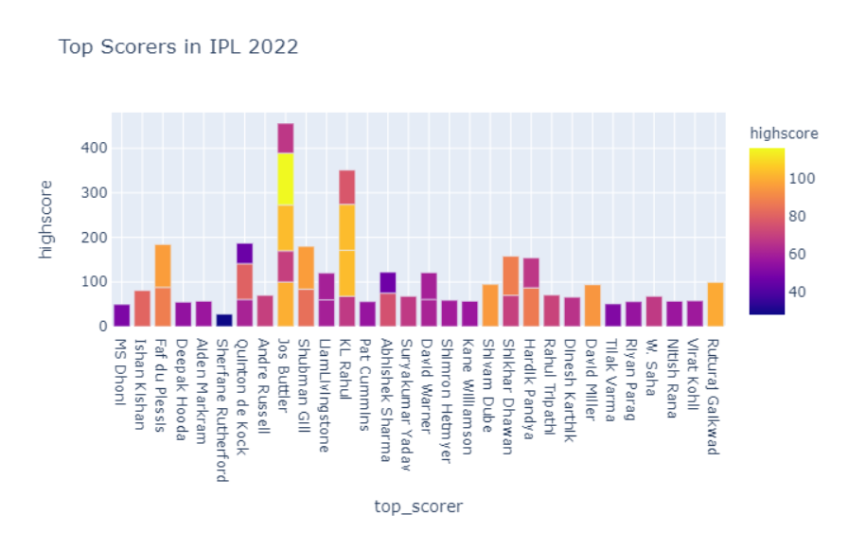
top scorers
In IPL 2022, Jos Butler has scored three centuries, and KL Rahul has scored two centuries.

Slide 8
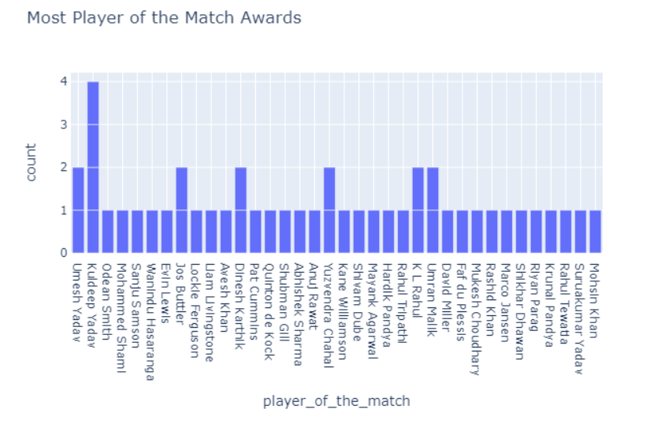
most player of the match awards
So Kuldeep Yadav is leading in the list of players of the match awards with four matches. It is a great tournament for Kuldeep Yadav this year.

Slide 9
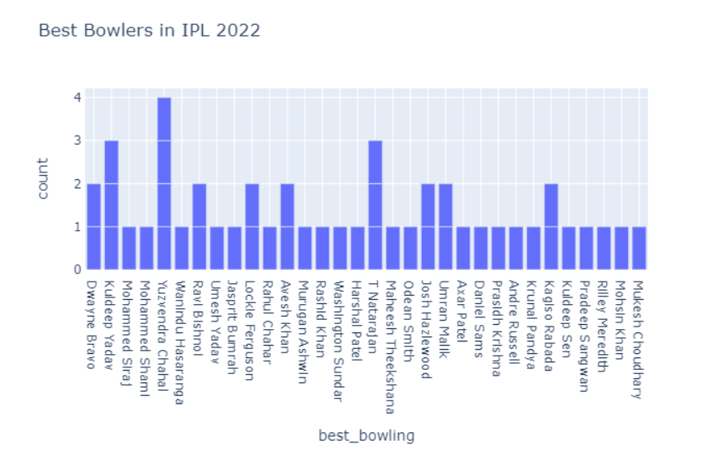
best bowling figures
You can see Yuzvendra Chahal having the best bowling figures in four matches. So this is a great tournament for Yuzvendra Chahal this year too.

Slide 10
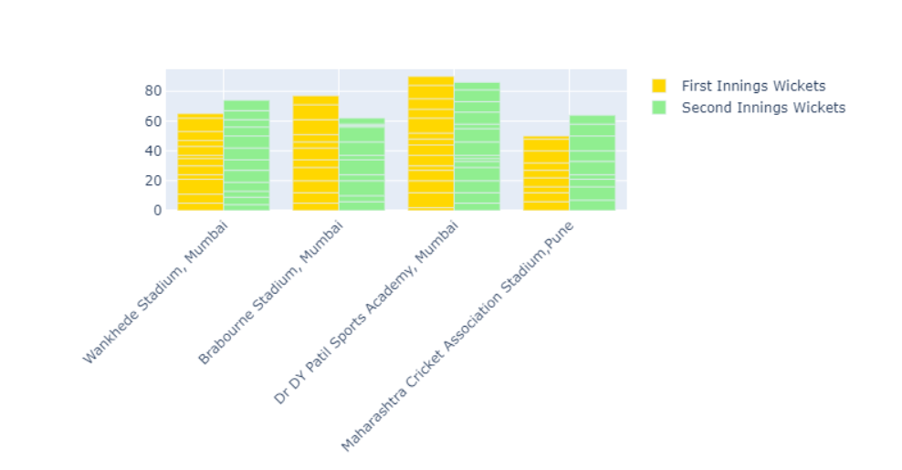
wickets fallen:
So in the Wankhede Stadium in Mumbai and MCA Stadium in Pune, most wickets fall while chasing the target. And in the other two stadiums, most wickets fall while setting the target.

Slide 11
Conclusion:
This analysis on IPL 2022 is done using Python.
IPL 2022 is going great for Gujrat as a new team this year. Jos Butler and KL Rahul have been great with the bat, and Yuzvendra Chahal and Kuldeep Yadav have been great with the bowl.

